Slide 1
RNA-seq Quality Control
Before the analysis begins
stefania.giacomello@scilifelab.se
asa.bjorklund@scilifelab.se

Slide 2
Overview
What can affect your data?
FastQC – read based QC
RSeQC – mapping based QC
PCA
Preventive measurements: spike-in controls, experimental design

Slide 3
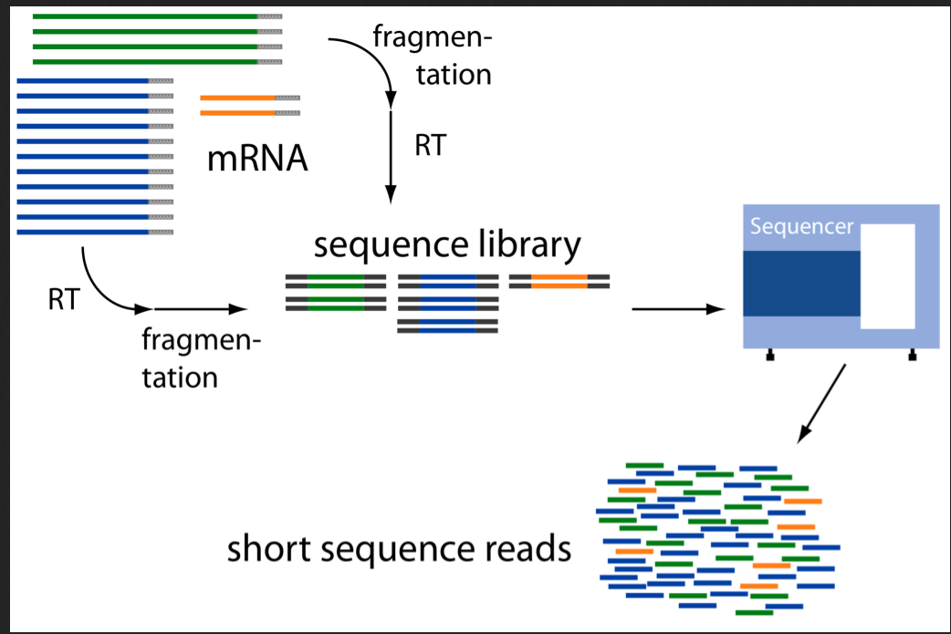
RNA-seq libraries
What could go wrong?

Slide 4
What could go wrong?
RNA quality:
Degradation
Contaminations (pathogens or other sources)
GC-bias
Nuclear vs organellar reads
Library prep:
Failed reactions
RNA / Adapter ratios – primer dimers
Clonal duplicates
Chimeric reads
Contaminations
Sequencing:
Base calling errors
Uncalled bases
Low quality bases (3’ end)
Contaminations
Sequence complexity

Slide 5
What could go wrong?
RNA quality:
Degradation
Contaminations (pathogens or other sources)
GC-bias
Nuclear vs organelle reads
Library prep:
Failed reactions
RNA / Adapter ratios – primer dimers
Clonal duplicates
Chimeric reads
Contaminations
Sequencing:
Base calling errors
Uncalled bases
Low quality bases (3’ end)
Contaminations
Sequence complexity

Slide 6
What could go wrong?
RNA quality:
Degradation
Contaminations (pathogens or other sources)
GC-bias
Nuclear vs organelle reads
Library prep:
Failed reactions
RNA / Adapter ratios – primer dimers
Clonal duplicates
Chimeric reads
Contaminations
Sequencing:
Base calling errors
Uncalled bases
Low quality bases (3’ end)
Contaminations
Sequence complexity

Slide 7
What could go wrong?
RNA quality:
Degradation
Contaminations (pathogens or other sources)
GC-bias
Nuclear vs organelle reads
Library prep:
Failed reactions
RNA / Adapter ratios – primer dimers
Clonal duplicates
Chimeric reads
Contaminations
Sequencing:
Base calling errors
Uncalled bases
Low quality bases (3’ end)
Contaminations
Sequence complexity

Slide 8
From samples to reads - may not be what you think they are
Mixing samples
Experiments go wrong
How do we understand what went wrong?

Slide 9
From samples to reads - may not be what you think they are
Mixing samples
Experiments go wrong
How do we understand what went wrong?
BIOINFORMATICS!

Slide 10
RNA-seq analysis workflow
reads.fastq.gz
STAR
mappedReads.bam
Reads
Mapping
Mapped reads
Gene annotation:
ref.bed / ref.gtf
Reference
genome.fa
Gene expression

Slide 11
Read QC
- FastQC
Mapping statistics
Mapping QC
- RseQC
reads.fastq.gz
STAR
mappedReads.bam
Reads
Mapping
Mapped reads
Gene annotation:
ref.bed / ref.gtf
Reference
genome.fa
Gene expression
Outlier detection, sample swaps

Slide 12
Fastq – read file format
Unique identifier
Sequence
@SEQ_ID
GATTTGGGGTTCAAAGCAGTATCGATCAAATAGTAAATCCATTTGTTCAACTCACAGTTT
+
!''*((((***+))%%%++)(%%%%).1***-+*''))**55CCF>>>>>>CCCCCCC65
Sequence quality
Paired end data usually in format sampleX_1.fastq and sampleX_2.fastq with same SEQ_ID for both mate pairs, followed by
/1 and /2 (or _f and _r)

Slide 13
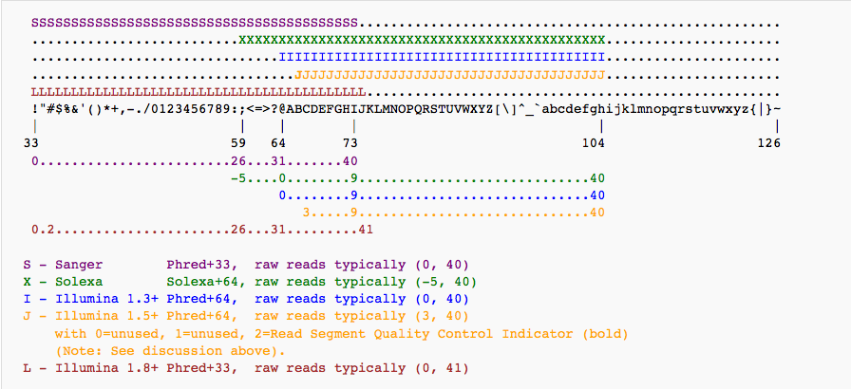
Fastq – read file format
@SEQ_ID
GATTTGGGGTTCAAAGCAGTATCGATCAAATAGTAAATCCATTTGTTCAACTCACAGTTT
+
!''*((((***+))%%%++)(%%%%).1***-+*''))**55CCF>>>>>>CCCCCCC65

Slide 14
Read QC
- FastQC
reads.fastq.gz
STAR
mappedReads.bam
Reads
Mapping
Mapped reads
Gene annotation:
ref.bed / ref.gtf
Reference
genome.fa
Gene expression

Slide 15
Basic read metrics with FastQC
A program that analyses some of the basic metrics on fastq raw read files.
Quality
Length
Sequence bias
GC content
Repeated sequences
Adapter contamination
Code
$ module load bioinfo-tools
$ module load FastQC/0.11.2
$ fastqc –o outdir seqfile.fastq
# multiple files:
$ fastqc –o outdir seqfile_*.fastq
http://www.bioinformatics.babraham.ac.uk/projects/fastqc/

Slide 16
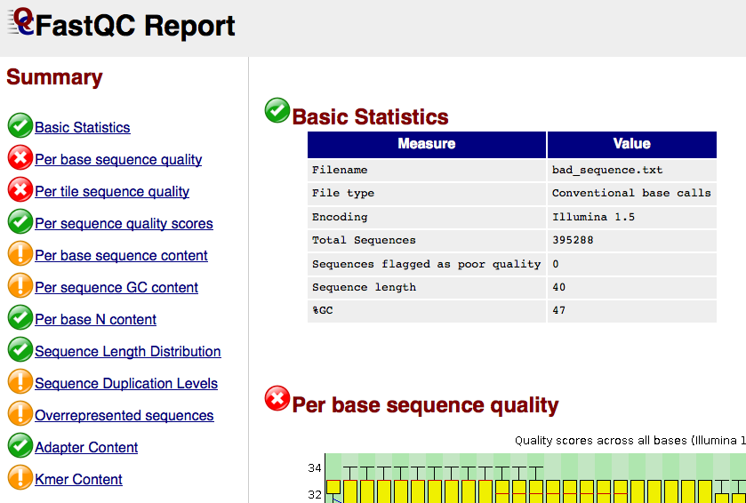
FastQC report

Slide 17
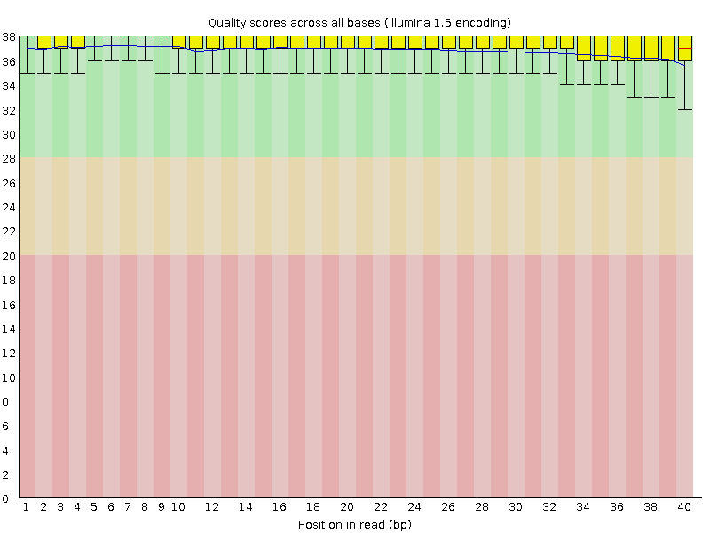
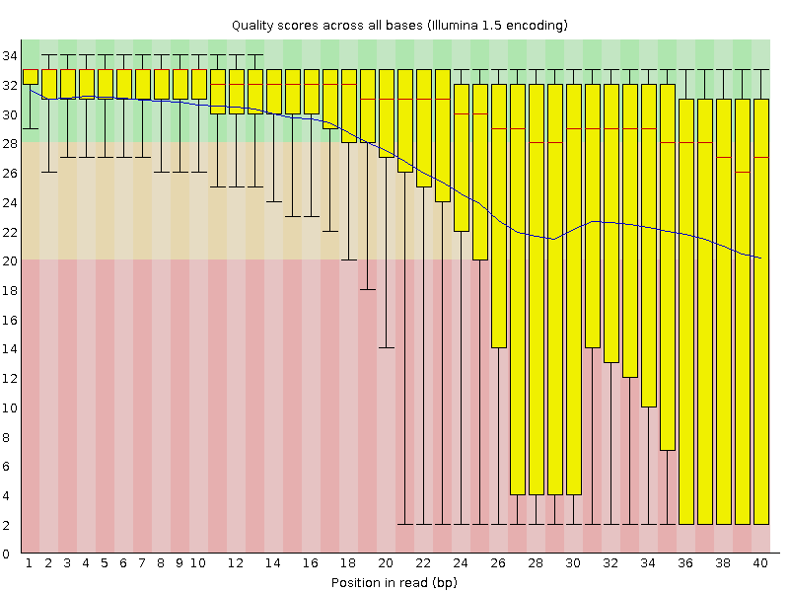
Per base sequence quality

Slide 18
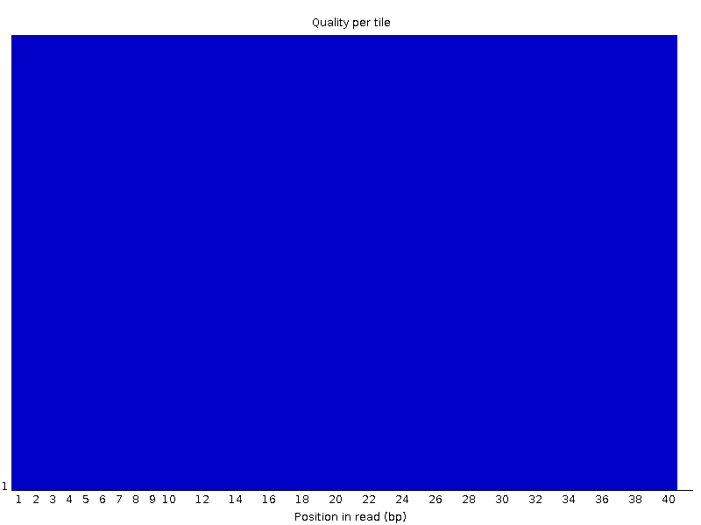
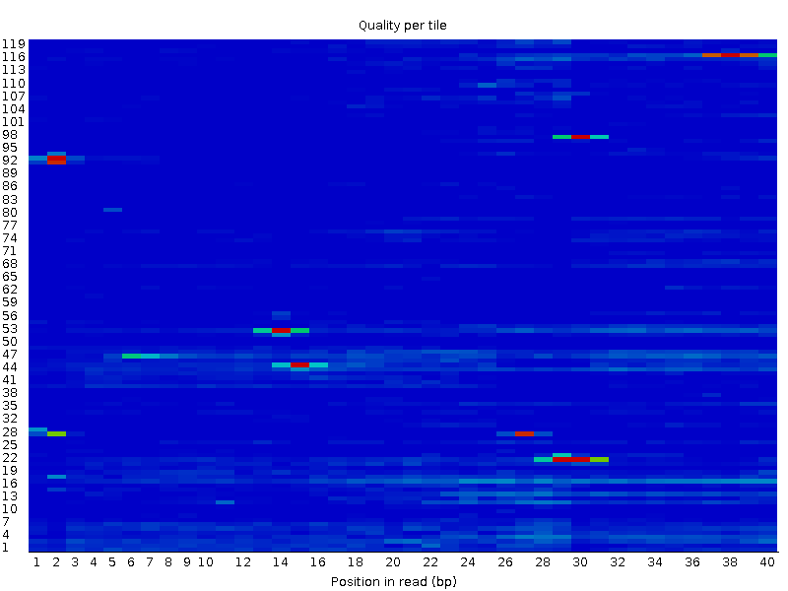
Per tile sequence quality (Illumina)

Slide 19
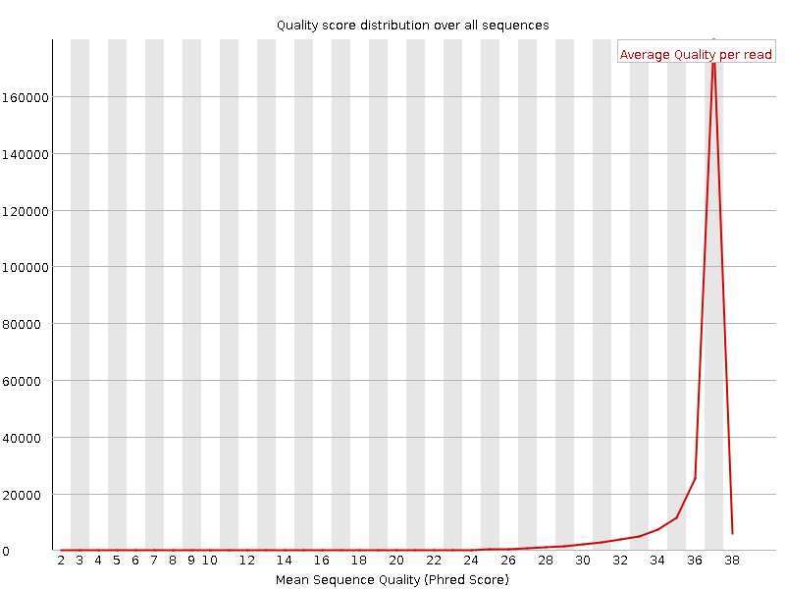
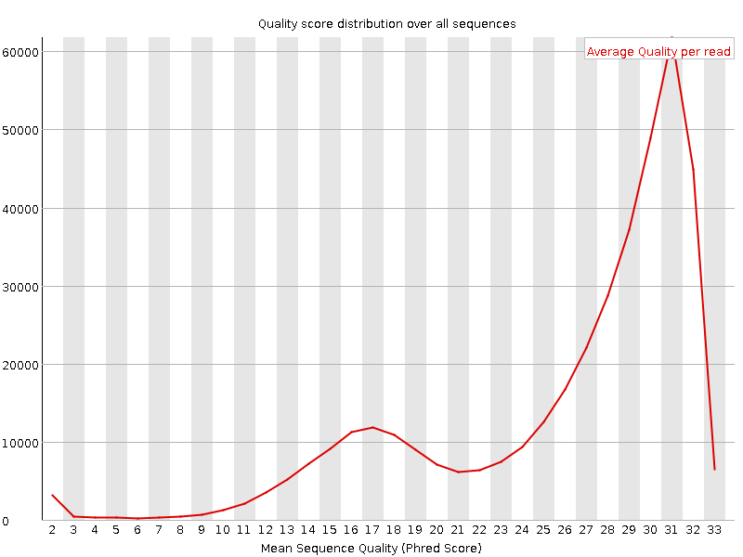
Per sequence quality scores

Slide 20
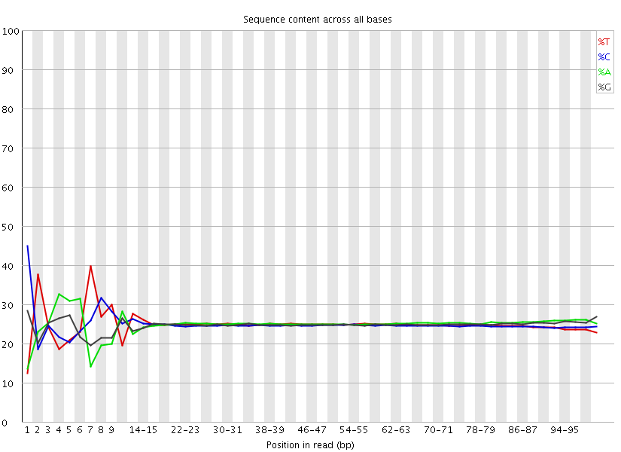
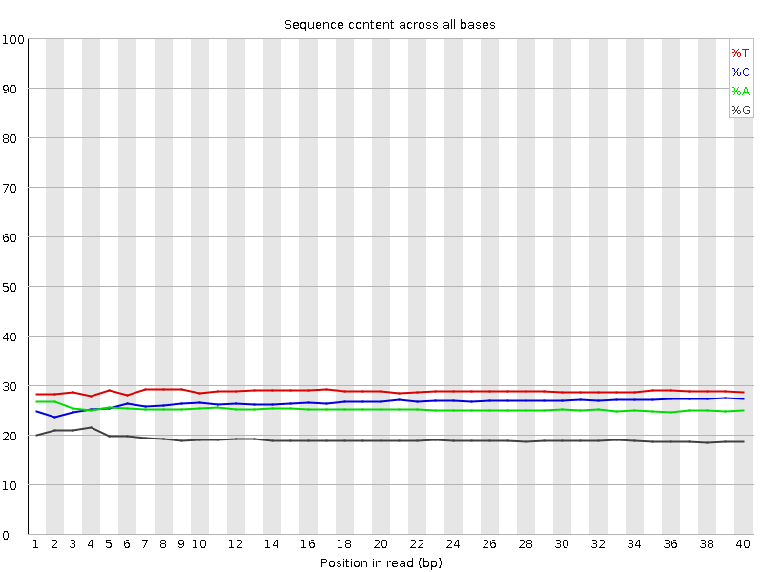
Per base sequence content

Slide 21
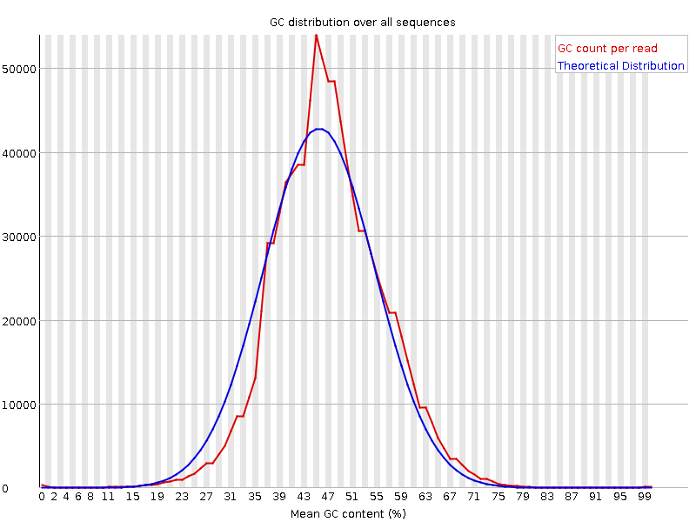
Per sequence GC content

Slide 22
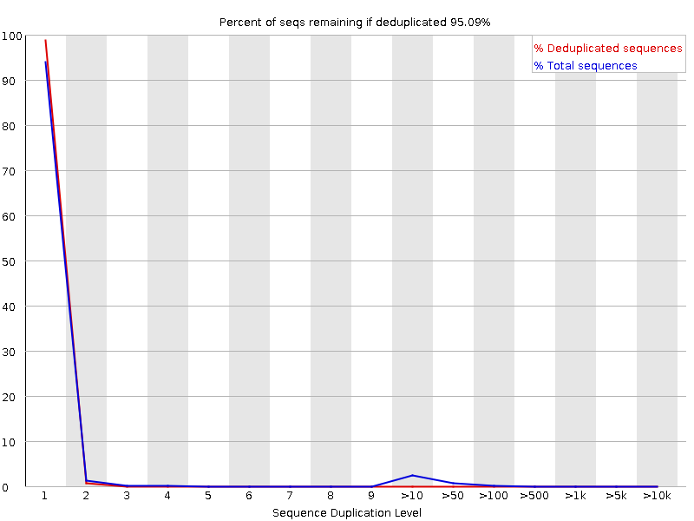
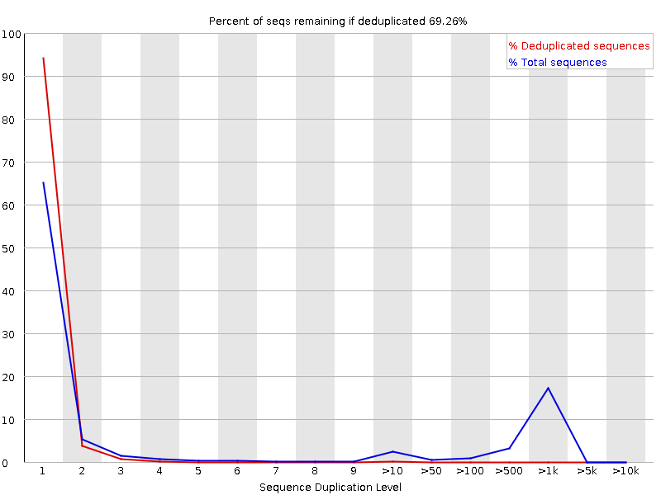
Sequence Duplication Levels

Slide 23
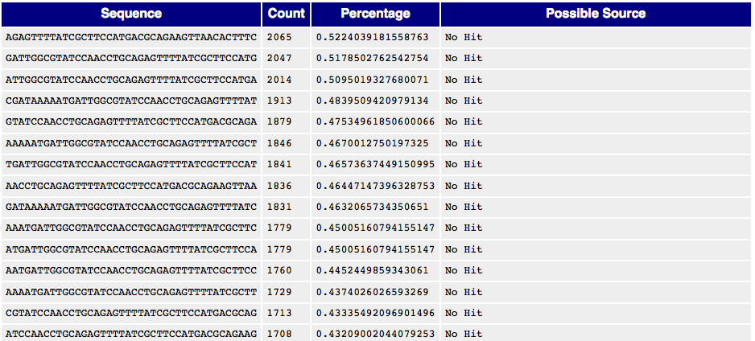
Overrepresented sequences

Slide 24
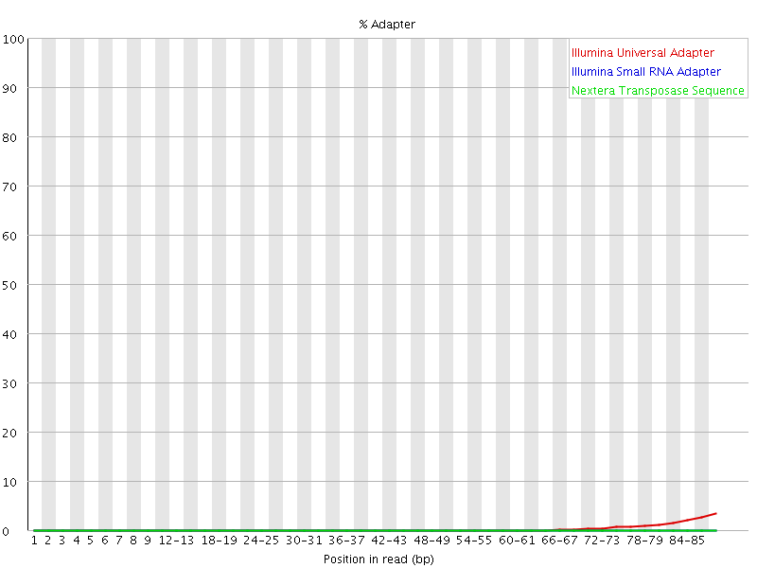
Adapter Content

Slide 25
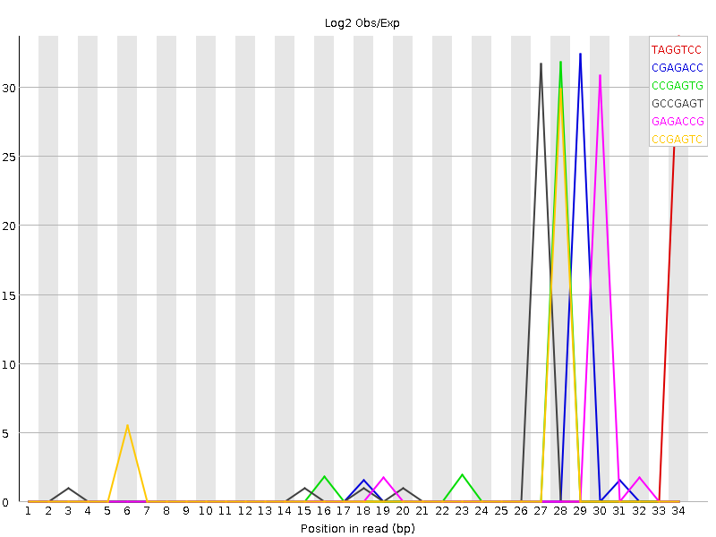
Kmer content

Slide 26
Failed FastQC – what to do?
Try to figure out why
If problem seem to be related to problems during sequencing – resequence!
If problem is related to library prep – rerun if possible.
You can filter out the low quality reads
Adapter trimming (cutadapt)
Filter low phred score reads (samtools, jaccard)
If you have enough reads after filtering the data may still be useful.
But be careful to do equal trimming on all samples!

Slide 27
Mapping statistics
reads.fastq.gz
STAR
mappedReads.bam
Reads
Mapping
Mapped reads
Gene annotation:
ref.bed / ref.gtf
Reference
genome.fa
Gene expression

Slide 28
Mapping logs – mapping efficiency
Program specific how the output will be (STAR, Bowtie, BWA, Tophat…)
Always gives:
% uniquely mapping – ideally around 90% for 100 bp reads
% multi-mapping – will depend on read length
% unmapped – could indicate contaminations, adaptors
Also statistics on:
Mismatches / indels
Splice junctions

Slide 29
Bad mapping – what to do?
First step – try to figure out why it failed. With the use of FastQC/RseQC/Mapping logs.
Perhaps also look for contaminant species
Redo library prep controlling for possible errors
Low mapping, but not completely failed.
Figure out why!
Is it equal for all samples?
Could it introduce any bias in the data?

Slide 30
Mapping QC
- RseQC
reads.fastq.gz
STAR
mappedReads.bam
Reads
Mapping
Mapped reads
Gene annotation:
ref.bed / ref.gtf
Reference
genome.fa
Gene expression

Slide 31
SAM/BAM file formats
All mapped reads with location in genome, mapping information etc.
SAM (Sequence Alignment/Map) format – alignment.sam
BAM is a compressed sam format – alignment.bam
A bam-file (always) needs to be indexed and sorted - alignment.bam.bai
Samtools – a simple program for converting between bam/sam, indexing, sorting, filtering, etc.
Code
$ module load bioinfo-tools
$ module load samtools

Slide 32
SAM/BAM file format
HWI-ST1018:7:1101:1648:2188#0 99 chr1 115275270 255 1S100M = 115275321 152 NTTCTATATTGGTTGCTCGCTCTAATTTGTCACGTCGGTCTGTTGAAATATTAAACCTAACATGGTCACCTTCCAGCAGGGTCACCTTGGATTTCGTATCT BS\cceeeggeggghhhhbghhhhhhhhhhfhhhhhhhfhhhhhhhffhhhffhhhfffgghhgg\Z^ddeeeedbdbdcacbabcbcccbbbcc^abbc] NH:i:1 HI:i:1 AS:i:194 nM:i:0
HWI-ST1018:7:1101:1648:2188#0 147 chr1 115275321 255 101M = 115275270 -152 AAACCTAACATGGTCACCTTCCAGCAGGGTCACCTTGGATTTCGTATCTTTGTCTCCAAAGGGAAGTTCTTTAGGGATCACAAAGTCNANTTTGNTNNGTC BBccbdccccccccbbcccccddcddeeeeccggggghihiiiiifhihfgiiihhhhihhihiiiihhiihiiiiihihhihgd]RBRBec]QBQBBbbb NH:i:1 HI:i:1 AS:i:194 nM:i:0
HWI-ST1018:7:1101:2039:2206#0 99 chr19 14574483 255 1S72M85N28M = 14574529 232 NCCTTCCGCAACCCTGTCATTGAGAGGATTCCTCGGCTCCGACGGCAGAAGAAAATTTTCTCCAAGCAGCAAGGGAAGGCGTTCCAGCGTGCTAGGCAGAT BP\cceeefgggghhighiiiiiiiiihhhiiiiihiiiiiiihiggeeedddddbbbcccbbccb^[`aaccccccccccX]accccc^acc]bc^b_a] NH:i:1 HI:i:1 AS:i:203 nM:i:0 XS:A:+
HWI-ST1018:7:1101:2039:2206#0 147 chr19 14574529 255 26M85N75M = 14574483 -232 GAAGAAAATTTTCTCCAAGCAGCAAGGGAAGGCGTTCCAGCGTGCTAGGCAGATGAACATCGATGTCGCCACGTGGGTGCGGCTGCTCCGGAGGCTCATCC ]ccdcccbbbacbcaccccbcccccccccccbcccaccccccccdd_dddeeeeeeeggggiiiiihihiiiiiiiihiihiiiiiiigfgggeeeeebbb NH:i:1 HI:i:1 AS:i:203 nM:i:0 XS:A:+
More details on:
http://samtools.github.io/hts-specs/SAMv1.pdf
http://genome.sph.umich.edu/wiki/SAM

Slide 33
After mapping - RseQC package
Code
$ module load bioinfo-tools
$ module load rseqc/2.4
$ geneBody_coverage.py –r ref.bed12 –i mappedReads.bam -o
genecoverage
General sequence QC:
sequence quality
nucleotide composition bias
PCR bias and
GC bias
RNA-seq specific QC:
evaluate sequencing saturation
mapped reads distribution
coverage uniformity
strand specificity
Etc..
Some tools for file manipulations
http://rseqc.sourceforge.net/

Slide 34
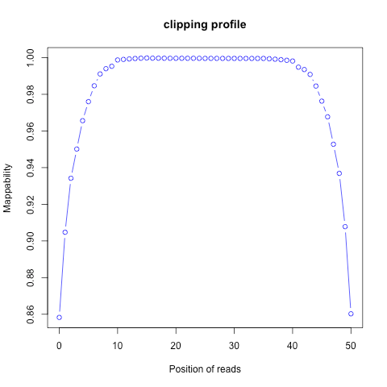
Soft clipping - clipping_profile.py

Slide 35
Gene coverage - geneBody_coverage.py
Not degraded
Degraded

Slide 36
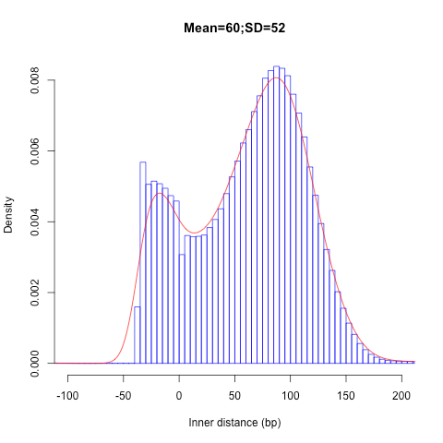
Distance between PE-reads - inner_distance.py

Slide 37
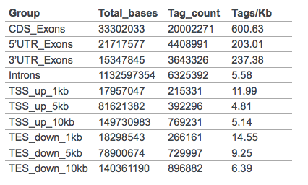
Where in the genome do your reads map? - read_distribution.py

Slide 38
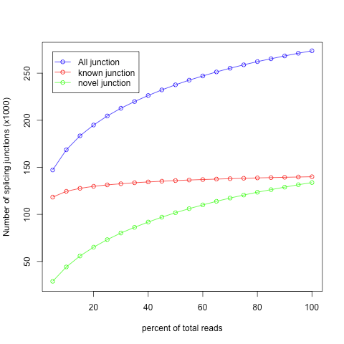
Known and novel splice junctions – junction_saturation.py or junction_annotation.py

Slide 39
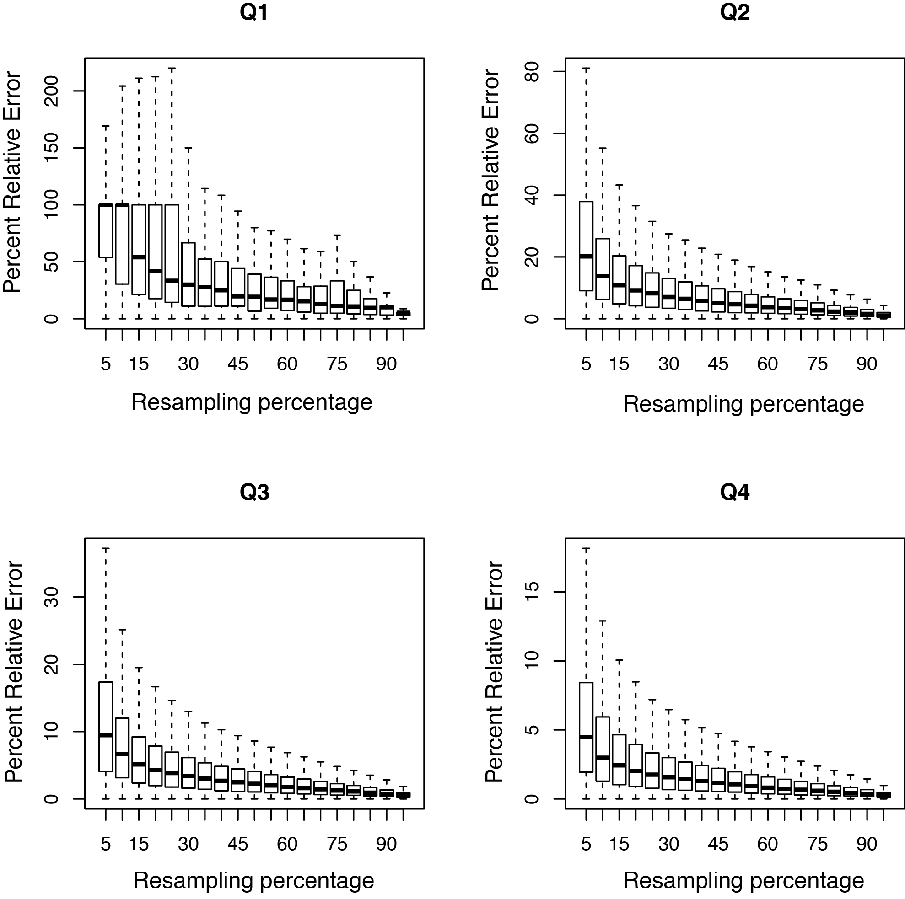
Gene detection subsampling - RPKM_saturation.py How deep do you need to sequence?

Slide 40
Bad RseQC output – what to do?
Try to figure out what went wrong.
Redo library prep controlling for possible errors
Is it equal for all samples?
Could it introduce any bias in the data?
RNA-degradation in some samples
Possible to use a region at 3’ end for expression estimates.

Slide 41
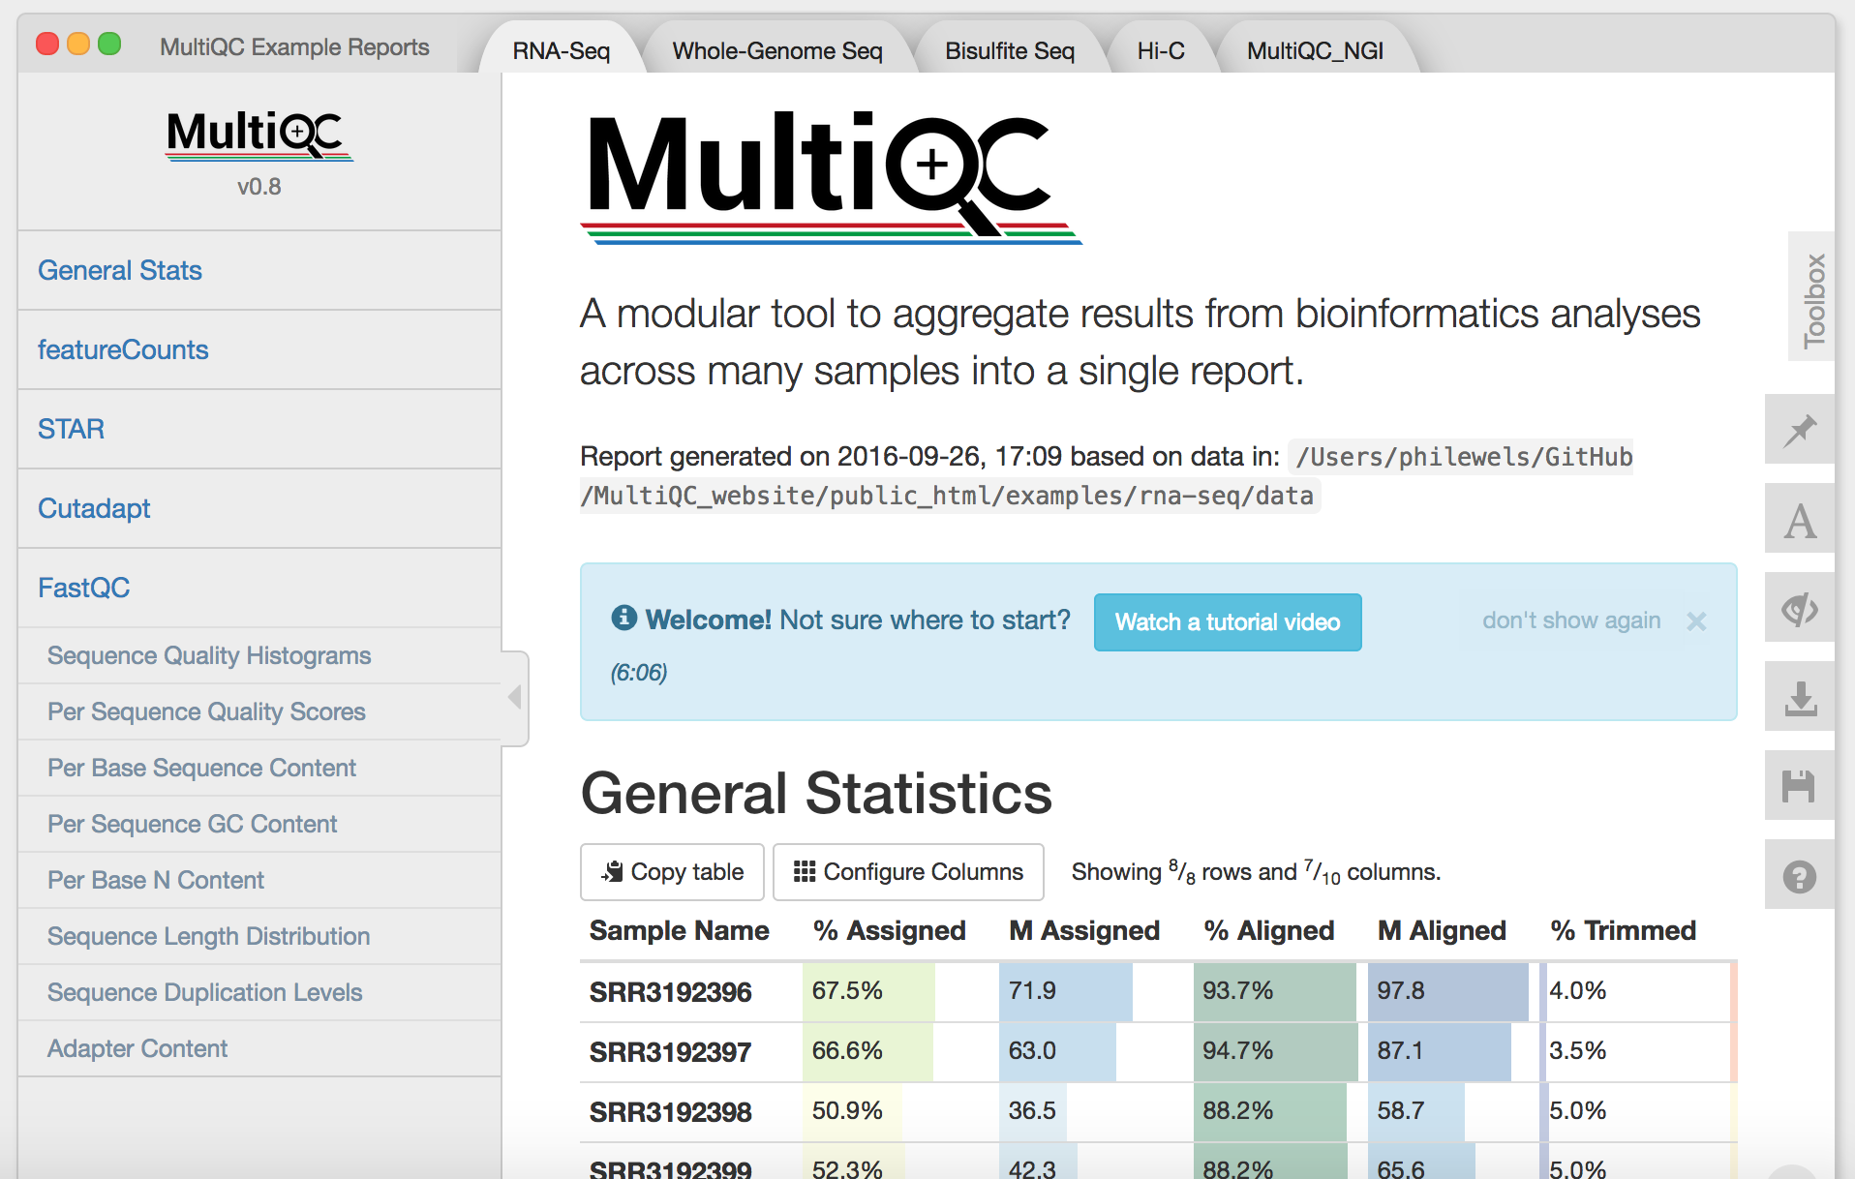
MultiQC – summary of QC stats
Code
$ module load bioinfo-tools
$ module load MultiQC
$ multiqc .
( http://multiqc.info/ )

Slide 42
reads.fastq.gz
STAR
mappedReads.bam
Reads
Mapping
Mapped reads
Gene annotation:
ref.bed / ref.gtf
Reference
genome.fa
Gene expression
Outlier detection, sample swaps

Slide 43
Sample swaps and outliers can be identified using PCA
Reads
Mapping
Mapped reads
Reads
Mapping
Mapped reads
Reads
Mapping
Mapped reads
Reference
Expression
per gene
Table with counts, rpkms, fpkms or similar
Reference
Expression
per gene
Reference
Expression
per gene
Reads
Mapping
Mapped reads
Reads
Mapping
Mapped reads
Reads
Mapping
Mapped reads
Reads
Mapping
Mapped reads
Reference
Expression
per gene
Reference
Expression
per gene
Reference
Expression
per gene
Reference
Expression
per gene

Slide 44
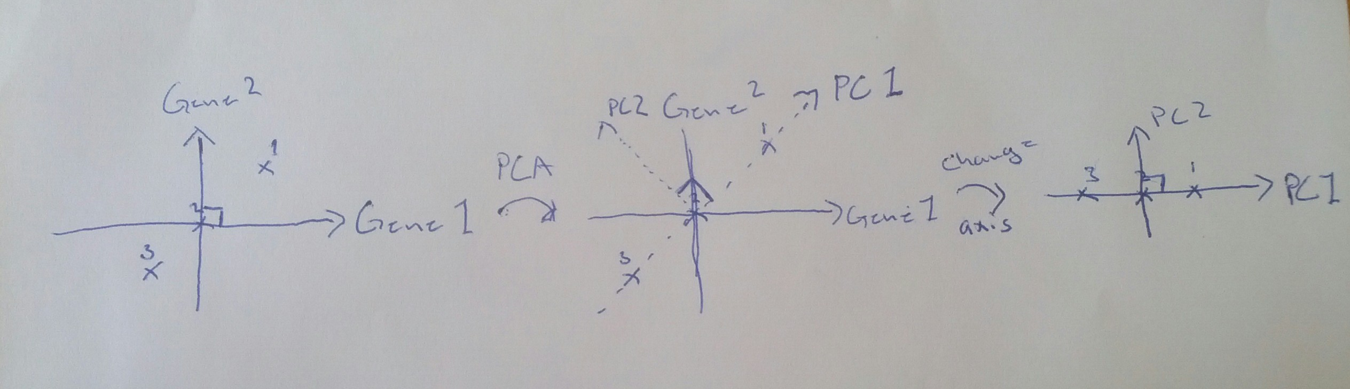
Differences in read distribution between samples can be identified using Principal Component Analysis (PCA)

Slide 45
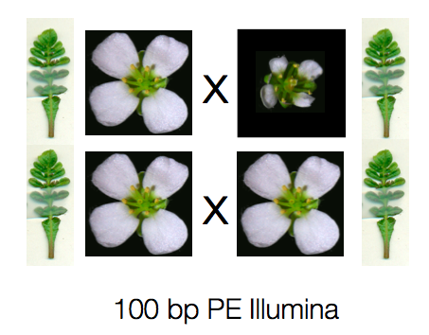
QC test case 1
Samples from three different species
C.rubella
Small flowers
Normal leaves
Genome is sequenced
C. grandiflora
Large flowers
Normal leaves
Hybrid
Intermediate flowers
Normal leaves

Slide 46
Principal component 1 separates samples from flowers and leaves
C. rubella

Slide 47
Principal component 2 and 3 separates the different species
C. rubella
C. rubella
hybrid
C. grandiflora

Slide 48

QC test case 2
4 Tissues
Fat body
Gut
Labial gland
Malphighian tubules
3 Phylogenetic groups
>70 samples

Slide 49
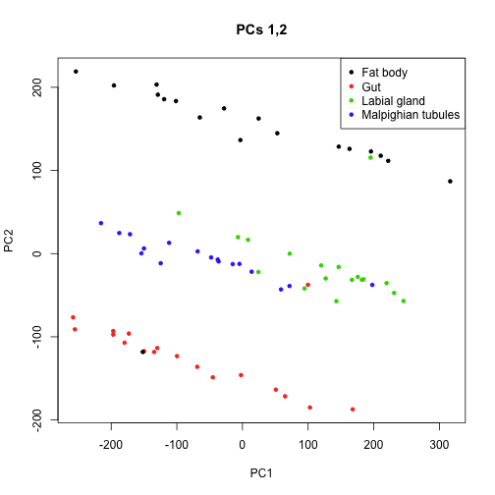
PCA analysis detected potential sample swaps

Slide 50
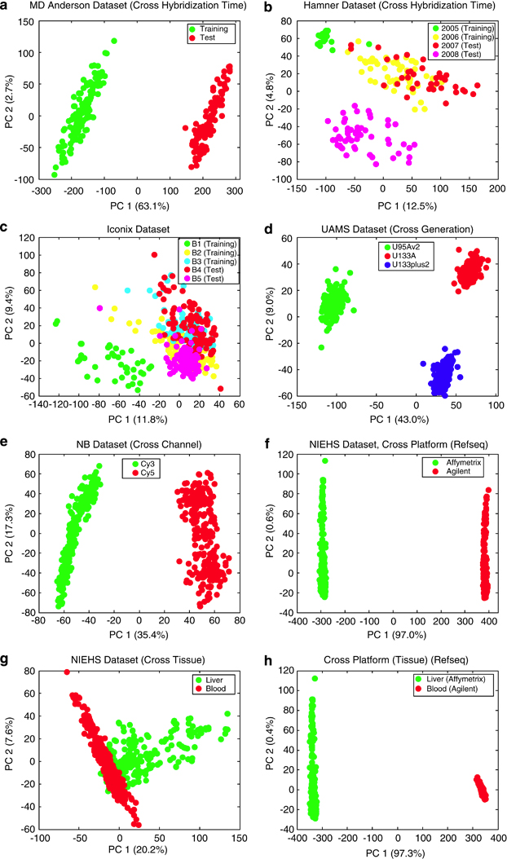
QC test case 3
PCA detects clear batch effect
(Luo et al. Pharmacogen. J. 2010)

Slide 51
My PCA looks strange – what to do?
Clear sample swaps
Check sequence indices, lab logs etc. to verify new classification.
If you have enough replicates, remove instead of changing labels if you are uncertain.
Clear batch effects
Can use batch normalization to remove the effect
Outliers
Figure out why they are outliers
Do not remove samples only because they do not fit your expectation – Bad science!
PCA does not group my sample sets
Try different methods of dimensionality reduction / clustering
Perhaps technical/biological variation is higher than your expected effect -> Batch normalization

Slide 52
Sources of variation
Biological variation
Patient to patient variation
Sex
Time points of samples taken
Etc…..
Technical variation
At each step of RNA extraction and library preparation

Slide 53
Spike-in control RNA
Addition of external RNA molecules into the samples before library prep
Will give estimate of technical variation:
Sensitivity / detection
Accuracy
Specific biases
Also used to estimate amount of RNA in the samples
Most commonly ERCC - pool of 48 or 96 synthetic mRNAs with various lengths and GC content, at 17 different concentrations
Allows for cross comparison of datasets

Slide 54
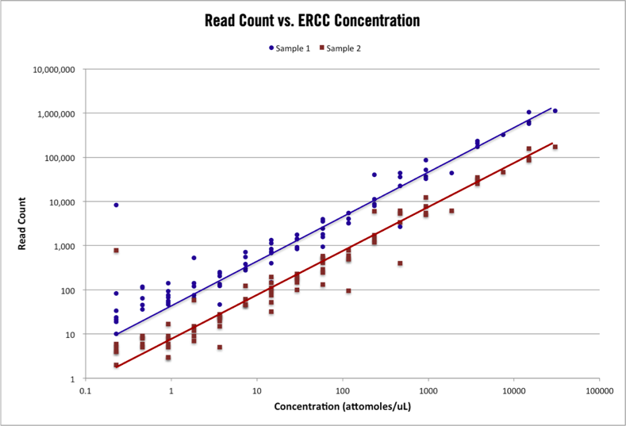
(https://cofactorgenomics.com)

Slide 55
Technical noise / Biological variation
Squared coefficient of variation: CV²
CV = std / mean

Slide 56
Replicates, replicates, replicates
Technical replicates
Biological replicates
If you have enough material, always do extra replicates in case you want to remove low quality samples.

Slide 57
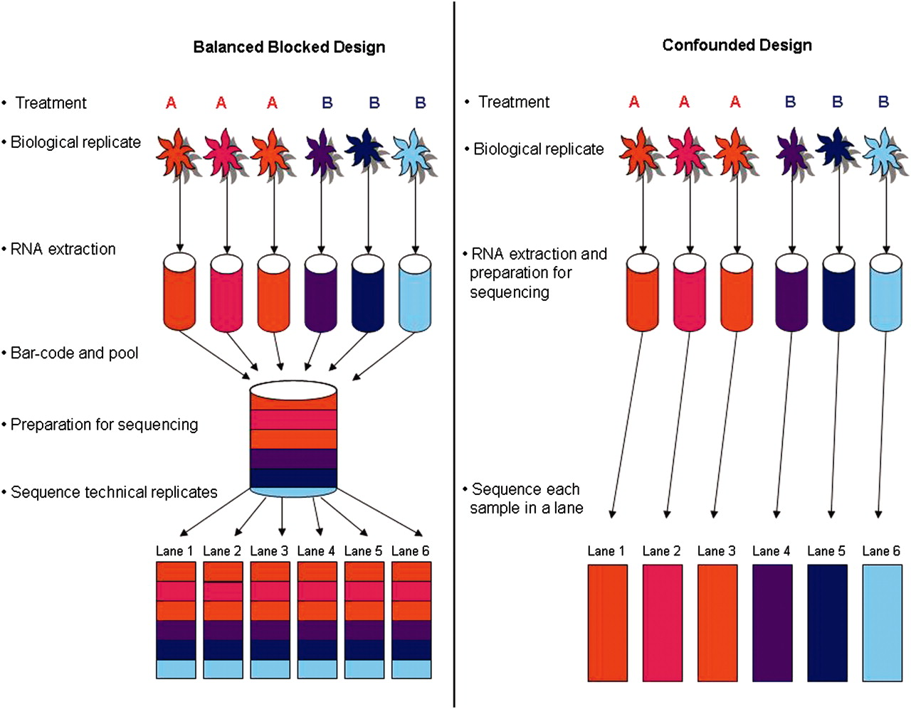
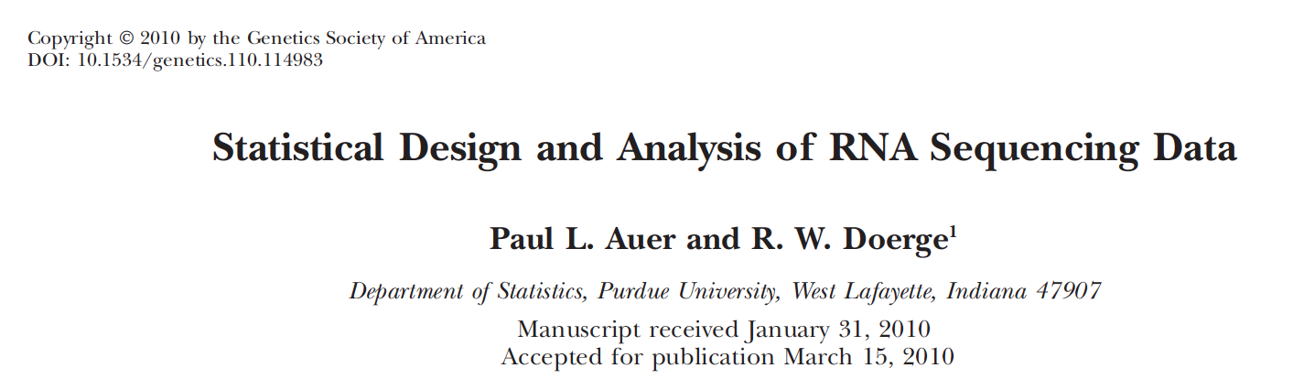
Experimental Design

Slide 58
Conclusions
Good quality data is the first step in any RNA-seq experiment
The reason for low quality samples may require some detective work
More replicates allows you to filter out low quality libraries without losing statistical power
Depending on where you sequence, some of the QC steps will be performed at the platform.

Slide 59
Questions?

